Slide 1
Support Vector Machines
林俊凡、小荣日子

Slide 2
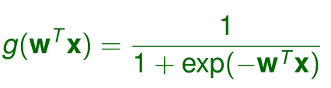
TWO-CLASS
Logistic Regression

Slide 3

TWO-CLASS

Slide 4

Function Margin

Slide 5


Geometric Margin

Slide 6
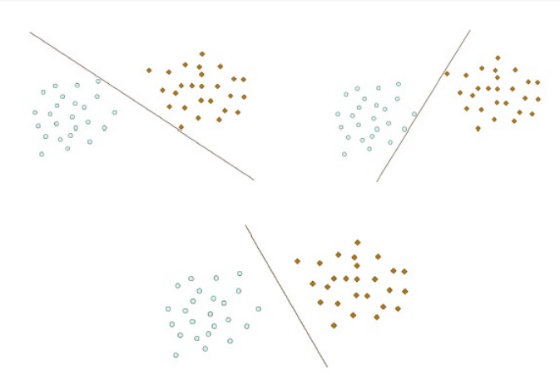
Optimal Separating Hyperplane

Slide 7


Primal Optimal Problem: or

Slide 8


Optimal Problem:

Slide 9



Lagrange Multiplier Method
Standard form problem
Lagrange Function:

Slide 10



Define
Standard form

Slide 11

Dual Problem:

Slide 12

Weak and Strong Duality
Weak duality:
always holds (for convex and nonconvex problem)
Strong duality:
does not hold in general

Slide 13

Assume strong duality holds, is primal optimal, is dual optimal, then

Slide 14





Karush-Kuhn-Tucker (KKT) Conditions
Let f(w) be convex
suppose hi(w) is affine,
gi(w) is strictly feasible

Slide 15
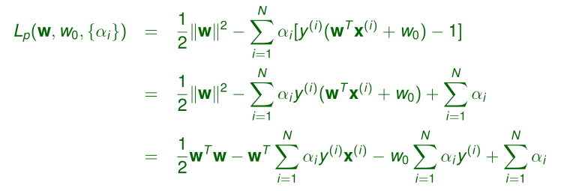

Slide 16

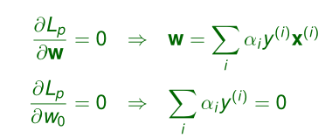
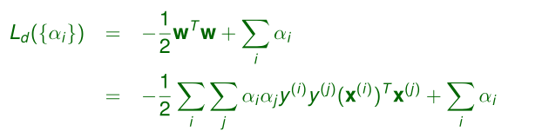
Eliminating Primal Variables
Setting the gradients of
Plugging (1) and (2) into gives the objective function for the dual problem:

Slide 17
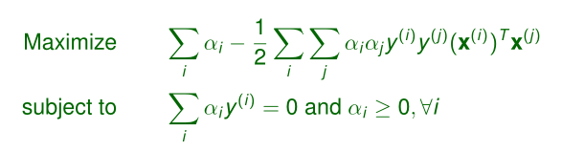
Dual Optimization Problem
Dual optimization problem:
This is also a QP problem, but its complexity depends on the sample
size N (rather than the input dimensionality D):

Slide 18

Support Vectors
Most of the dual variables vanish with . They are points lying
beyond the margin with no effect on the hyperplane.
Support vectors: , hence the name support vector
machine (SVM).

Slide 19
Classification
Soft Margin & Hard Margin
Kernel Function

Slide 20

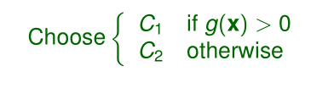
Two classes classification
Discriminant function
Classification rule during testing:

Slide 21
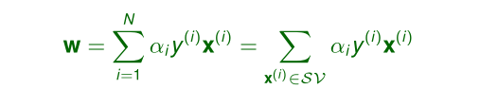
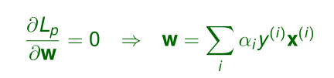

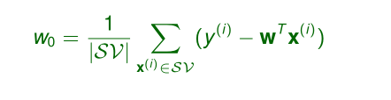
Identify w,w0
For numerical stability : all support vectors are used to compute w0 :

Slide 22

Case with multiple classes
One way to handle multiple classes is to define K two-class problem, each separating one class from all other classes combined.
An SVM g k (x) is learned for each two-class problem.
Classification rule during testing:

Slide 23
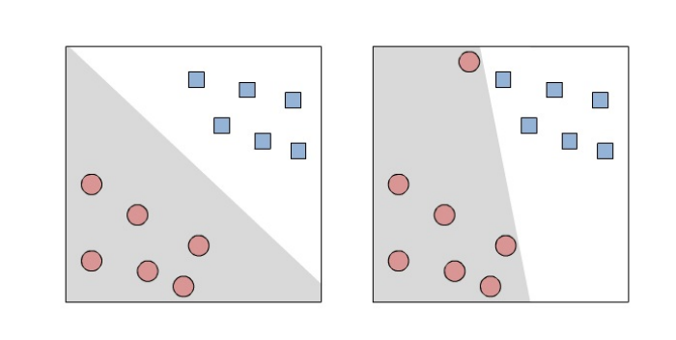

Hard margin with outliers

Slide 24


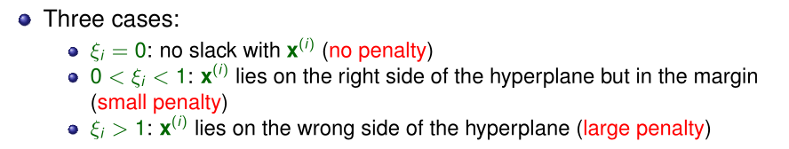
slack variables
slack variables
separation constraints

Slide 25
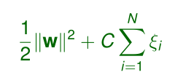
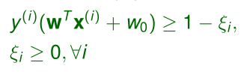
primal optimization problem
Minimize
subject to
C is a regularization parameter, which trades off between margin maximization and training error minimization

Slide 26
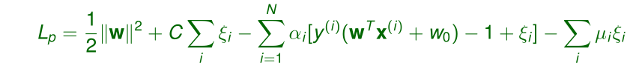
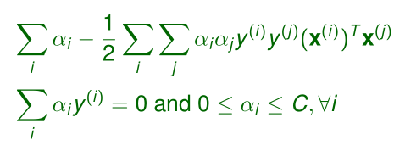
optimization
Lagrangian
Dual optimization problem
Maximize
subject to

Slide 27
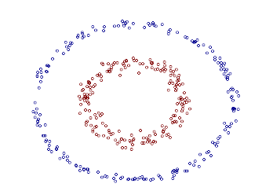
What if the sample space can not be linearly separated
Idea(2 step):
1.map the data space to
the high-dimension space
2.classify on the new data space

Slide 28
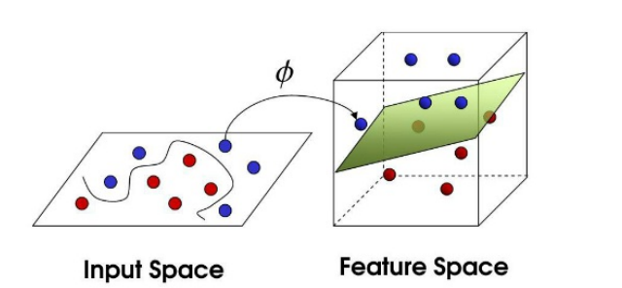

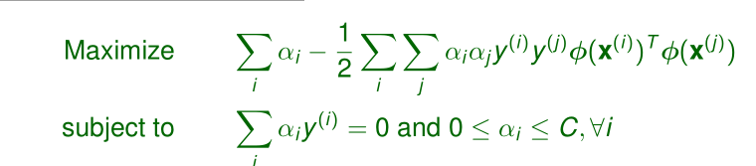
Basis functions:
Dual optimization problem:

Slide 29
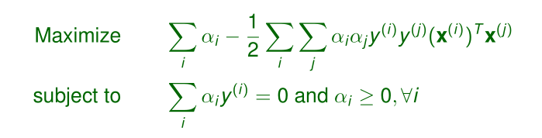

Comparison the optimal problem
Before mapping
After mapping

Slide 30





Kernel Methods
Define mapping ：
z =f(x1,x2)= (z1,z2,z3,z4,z5)
Two points：

Slide 31
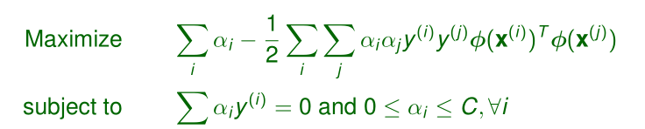
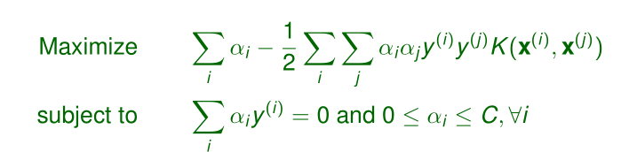

Kernel Function
Dual optimization problem:
or
where K(x (i) ,x (j) ) ≡ φ(x (i) ) T φ(x (j) ) is a kernel function defined
directly on the inputs x (i) and x (j) .

Slide 32


Some Common Kernel Functions
Polynomial kernel：
The dimension of new space is
m ：the dimension of the original space
d ： the degree of the polynomial

Slide 33
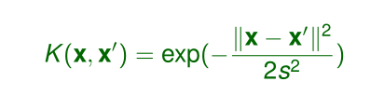
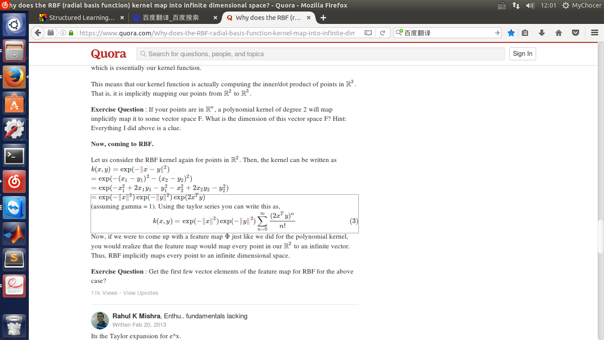
Radial basis function (RBF) kernel:
map into infinite dimensional space

Slide 34
s-SVM & ε-SVM(SVR)
Two special form of SVM

Slide 35
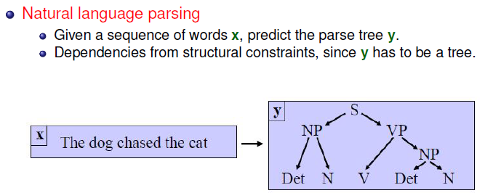
s-SVM：Structured SVM
Supervised Learning with Complex Output
Example:

Slide 36
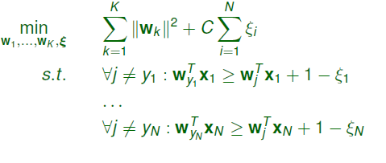
s-SVM
Way 1: Treat the complex output problem as a multi-class task
Then:
Where K is the number of classes and N is the number of training data

Slide 37

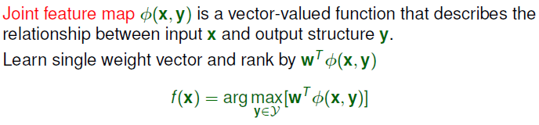
s-SVM
Way 1’s setback:
Too much parameters when K is big!
Way 2: Learn single weight vector and rank by , which is in fact a binary classification problem.

Slide 38
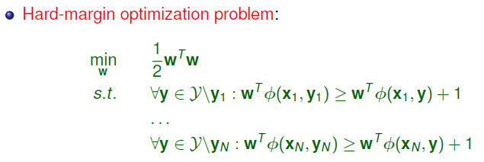
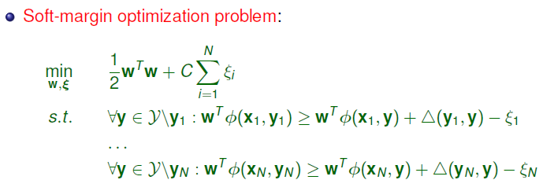
s-SVM

Slide 39
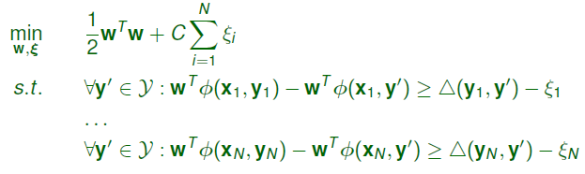


s-SVM
N-slack formulation:
1-slack formulation:

Slide 40

s-SVM
Since the set Y of possible output structures is generally quite large, enforcing all margin constraints is not feasible in practice.
Cutting planes can be applied to efficiently find a small working set of active constraints which are sufficient to optimize w within some prescribed tolerance.
Separation oracle: given a fixed w and input point xi , outputs the structure corresponding to the margin constraint for xi which is most violated by w:
Focusing on the constraints that are violated the most by the current model.

Slide 41
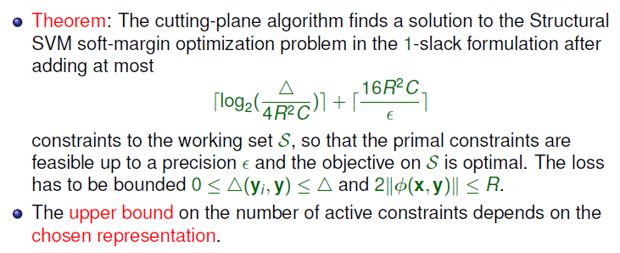
s-SVM

Slide 42
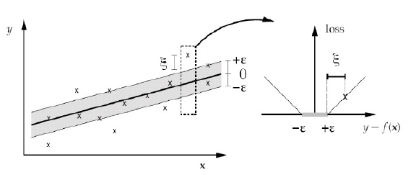
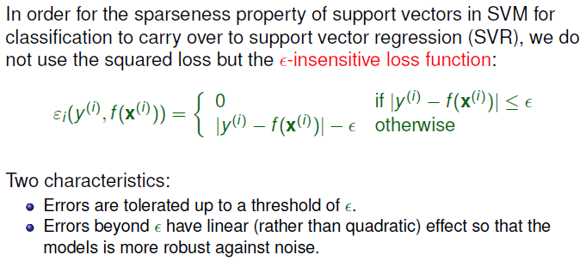
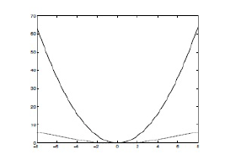
SVR

Slide 43



SVR
Target(Hard Margin)
Introduce slackness

Slide 44
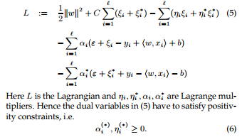

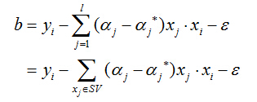

SVR：http://alex.smola.org/papers/2003/SmoSch03b.pdf
Dual Optimization

